Slide 1
Calculating moving averages of crypto prices
Notes:
[Mandatory Slide] This would be the introduction slide of the topic that you are covering in this subsection.
When this slide plays, you could talk about the main aim that we’d be covering in this video.

Slide 2
In this Video, we are going to take a look at…
SMAs and EMAs
Code sample: calculate SMAs and EMAs for cryptos
Notes:
[Mandatory Slide]
Before the start of the video, we’d like to highlight what are important topics or pointers that we’d be covering in this video. This slide would immediately follow the intro/name slide. This would just be say 2-3 points for the viewers to know what they are getting into.

Slide 3
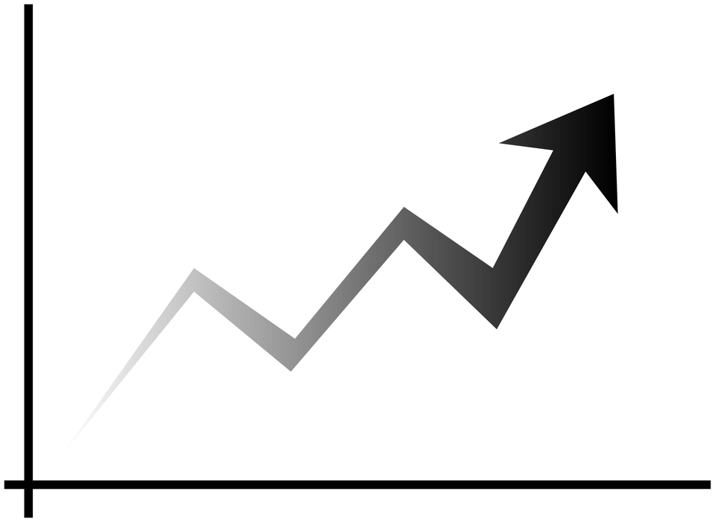
SMAs and EMAs (1/3)
Moving Averages (MAs) are widely used indicators in technical analysis that helps smooth out price lines by filtering out the “noise” from random price fluctuations.
MAs follow price trend directions and are useful to determine support and resistance levels
Nevertheless they come with a lag because they need a certain number of past price samples to be calculated
There are two commonly used types of MAs:
Simple Moving Averages (SMAs)
Exponential Moving Averages (EMAs)
Notes:
[Mandatory Slide]
Before the start of the video, we’d like to highlight what are important topics or pointers that we’d be covering in this video. This slide would immediately follow the intro/name slide. This would just be say 2-3 points for the viewers to know what they are getting into.

Slide 4
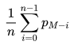
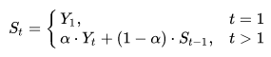
SMAs and EMAs (2/3)
Simple Moving Average (SMA) is a mathematical moving average calculated on a range of M time periods
one usually calculates short, medium and long SMAs and compares them
M is also the lag of the SMA in following the change in signal trends
Exponential Moving Average (EMA) is a mathematical weighted moving average calculated on a range of M time periods
different α weighs are applied to prices: more recent prices weigh more
EMA for a given day depends on EMAs for all the previous days
one usually calculates short, medium and long EMAs and compares them
because of the weighs, the lag in following signal trends is reduced with respect to a SMA
Math formulas credits: https://en.wikipedia.org/wiki/Moving_average
Notes:
[Mandatory Slide]
Before the start of the video, we’d like to highlight what are important topics or pointers that we’d be covering in this video. This slide would immediately follow the intro/name slide. This would just be say 2-3 points for the viewers to know what they are getting into.

Slide 5
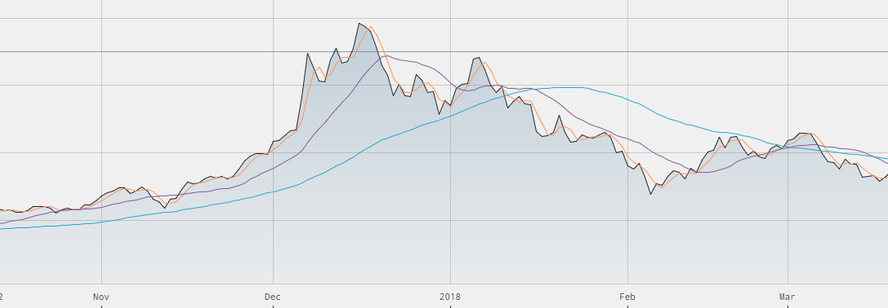
SMAs and EMAs (3/3)
Price line
3-days SMA
15-days SMA
50-days SMA
MAs crossovers can be used as signals for bullish/bearish trends identification
Notes:
[Mandatory Slide]
Before the start of the video, we’d like to highlight what are important topics or pointers that we’d be covering in this video. This slide would immediately follow the intro/name slide. This would just be say 2-3 points for the viewers to know what they are getting into.

Slide 6
Code Sample: calculate SMAs and EMAs for cryptos
Notes:
Something that needs to grab the viewers attention!!

Slide 7
Summary
SMAs and EMAs
Code sample: calculate SMAs and EMAs for cryptos
Notes:
[Mandatory Slide]
Before the start of the video, we’d like to highlight what are important topics or pointers that we’d be covering in this video. This slide would immediately follow the intro/name slide. This would just be say 2-3 points for the viewers to know what they are getting into.

Slide 8
Better visualizations for crypto prices
Next Video
Notes:
[Mandatory Slide]
Here the name of the next video needs to be mentioned. The narration as you guessed it would be just letting the viewer know exactly where we are at and what we’d be taking over next! ☺

